Slide 1
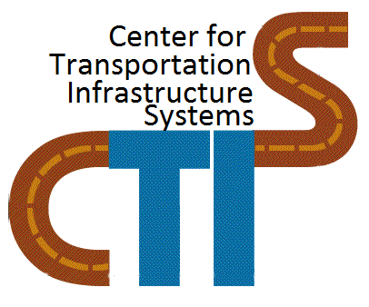



Transportation Leadership Council (TLC)
UTEP Chapter

Slide 2
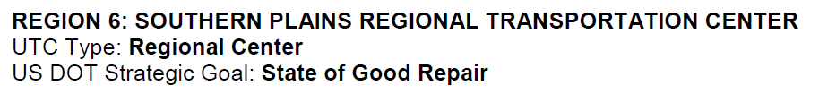

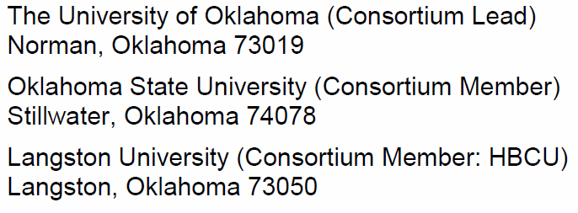
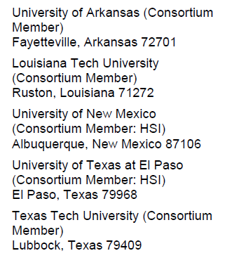
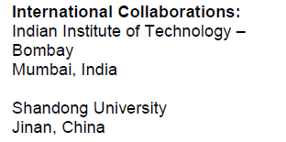


SPRTC Core Leader at UTEP : Dr. Soheil Nazarian

Slide 3
SPRTC Vision
Our vision is to be a diverse and inclusive regionally-based, nationally-recognized research, education and outreach center dedicated to solving pressing transportation and freight infrastructure problems and producing highly trained transportation professionals.

Slide 4
SPRTC Mission
To develop comprehensive, cost-effective, and imminently implementable solutions to critical infrastructure-related issues facing the transportation systems of the region and the nation.
To prepare transportation professionals for leadership roles in professional and research careers in support of the nation’s transportation system.

Slide 5
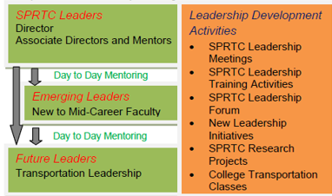
SPRTC Core Leader at UTEP : Dr. Soheil Nazarian

Slide 6
Transportation Leadership Council (TLC)
Student-led group that provides opportunities for developing leadership. There will be TLC chapter at each member institution.
The chapters will have autonomy to perform leadership development activities locally; however, a central mission will be to develop regional collaborative activities with other chapters.
Funds from the SPRTC Events will be allocated to support the TLC activities. TLC chapters will also be able to request funding to support other leadership development activities such as travel expenses to TRB/ ASCE/ARTBA meetings for students.

Slide 7
Senior Leadership Advisory Committee
Andrea Gutierrez : Former ASCE President
Cristobal Robles : ASCE President
Elizabeth Montes : TSPE President
Estefany Ramos : Former ASCE President
Fernando Soto : TSPE Vice-President
Henry Benitez : Chi Epsilon President
Marc Tarango : Chi Epsilon Vice President
Faculty Advisor and Mentor: Dr. Carlos Chang

Slide 8
TLC UTEP Chapter Our Purpose
The purpose of TLC Student Chapter is to promote the collaboration of multi-disciplinary transportation professionals and UTEP students by fostering the development of leadership, teamwork, networking, and research skills through the activities conducted by the Chapter.

Slide 9
TLC Activities
Present Research Work in Conferences
Conduct monthly meetings with presenters from the transportation community.
Participate in quarterly conference calls (Chapter officers)
Support community Service Opportunities (i.e. Project Move, TCM)
Promote Networking Opportunities (i.e. Career Expo, TSPE Engineering Mixer)

Slide 10
Conference Opportunities
Transportation Research Board – Washington D.C. – Jan 10-14, 2016
International Conference on Transportation & Development – Houston, TX. – June 26-29, 2016
11th National Conference on Transportation Asset Management – Minneapolis, MN.-July 10-12, 2016
11th International Conference on Concrete Pavements – San Antonio, TX. – August 28-31, 2016

Slide 11

Transportation Research Congress – Bejing, China – June 6-8, 2016
World Conference on Pavement Asset Management
Milan, Italy – June 12-16, 2016
Eighth International Conference on Maintenance & Rehabilitation of Pavement – Singapore – July 27-29, 2016
World Conference on Pavement & Asset Management – Warsaw, Poland – June 16, 2017
Tenth International Conference on the Bearing Capacity of Roads, Railways and Airfields – Athens, Greece – June 30, 2017

Slide 12
TLC Membership
Membership is open to all students (Undergraduate and Graduate) with interest in the transportation field. There will be no membership dues charged to students at this time.

Slide 13
TLC UTEP Officers
President
Vice President
Treasurer
Secretary
International Ambassador
Faculty Advisor and Mentor: Dr. Carlos Chang

Slide 14
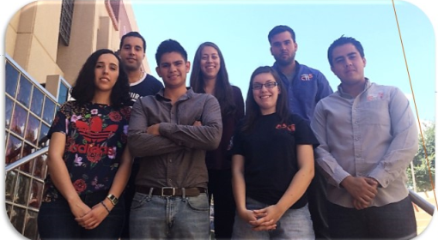
Thank you !
Join the TLC UTEP Student Chapter !!!

